Slide 1
The DRS Project Toolkit
A Scalable Model for Digital Projects

Slide 2
Overview
About the Digital Scholarship Group
The Digital Repository Service
DRS Project Toolkit Pilot Timeline
Toolkit Goals
Pilot Planning
Toolkit Implementation
Scalability, Sustainability, and Future Planning

Slide 3
Digital Scholarship Group
The Library’s Digital Scholarship Group (DSG) partners with these research efforts through an agenda of applied research that draws upon a wide range of expertise in data modeling, digital publishing, digitization, metadata, text encoding and user experience, and by running workshops, hosting scholarly events, collaborating with other units on campus, and by offering practical help with traditional and evolving methodologies.
DSG Toolkit Team
Param Ajmera,
David Cliff, Senior Digital Library Developer
Dave Decamp,
Julia Flanders, Director, Digital Scholarship Group
Abbie Levesque, DSG Coordinator
Jim McGrath, DSG Coordinator
Greg Palermo,
Amanda Rust, Assistant Director, Digital Scholarship Group
Sarah Sweeney, Digital Repository Manager
Patrick Yott, Associate Dean, Digital Strategies and Services
Eli Zoller, Web Developer and Designer

Slide 4
DRS Project Toolkit Goals
To provide a lightweight and sustainable model for preserving and displaying/distributing project materials.
To provide Northeastern projects with a low-barrier customized website to share project work.
To support Northeastern projects by preserving project materials in the DRS.
To encourage collaborative development between sites (part of sustainability?)

Slide 5
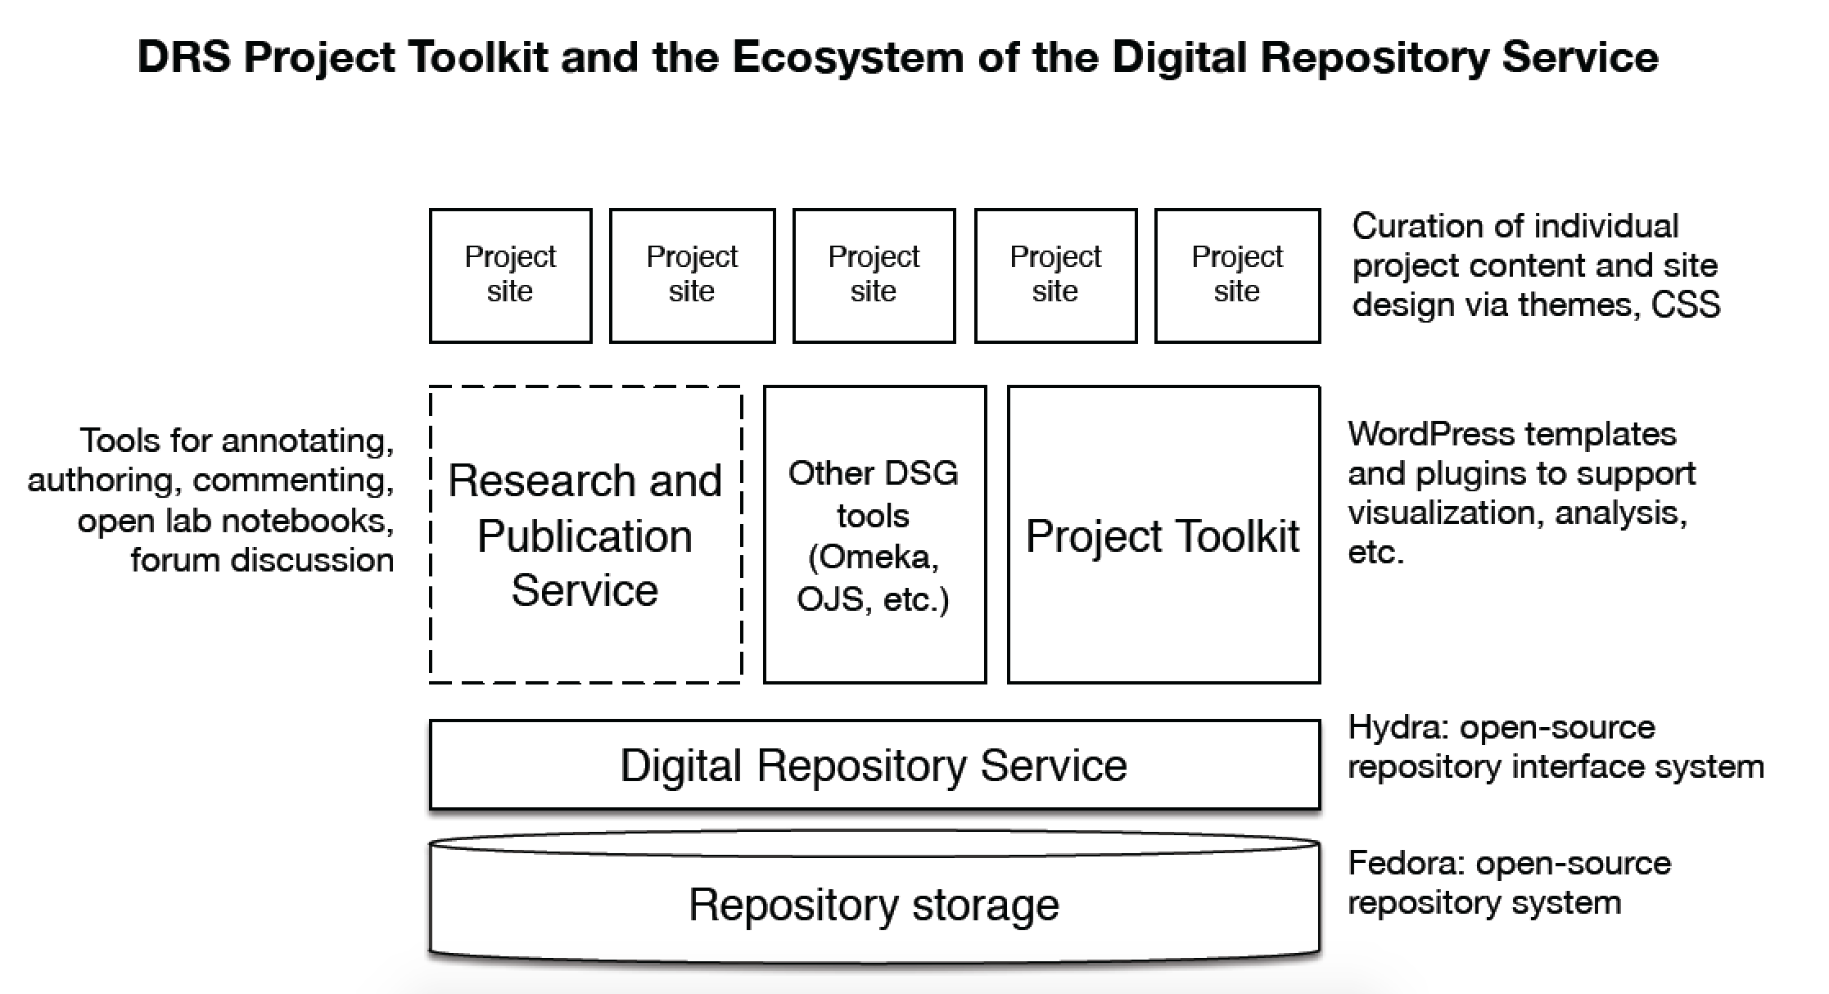
Credit: J. Flanders

Slide 6
DRS Project Toolkit Timeline
October 2014 | Toolkit planning begins
February 2015 | DRS Project Toolkit Call for Proposals
March 2015 | Work Specification Design
April 2015 | Project Selection
May 2015 | Project work begins
 | API Development begins
 | Wordpress Development begins
August 2015 | Wordpress template alpha testing
September 2015 | Wordpress tweaks
October 2015 | Wordpress template complete, shipped to projects

Slide 7
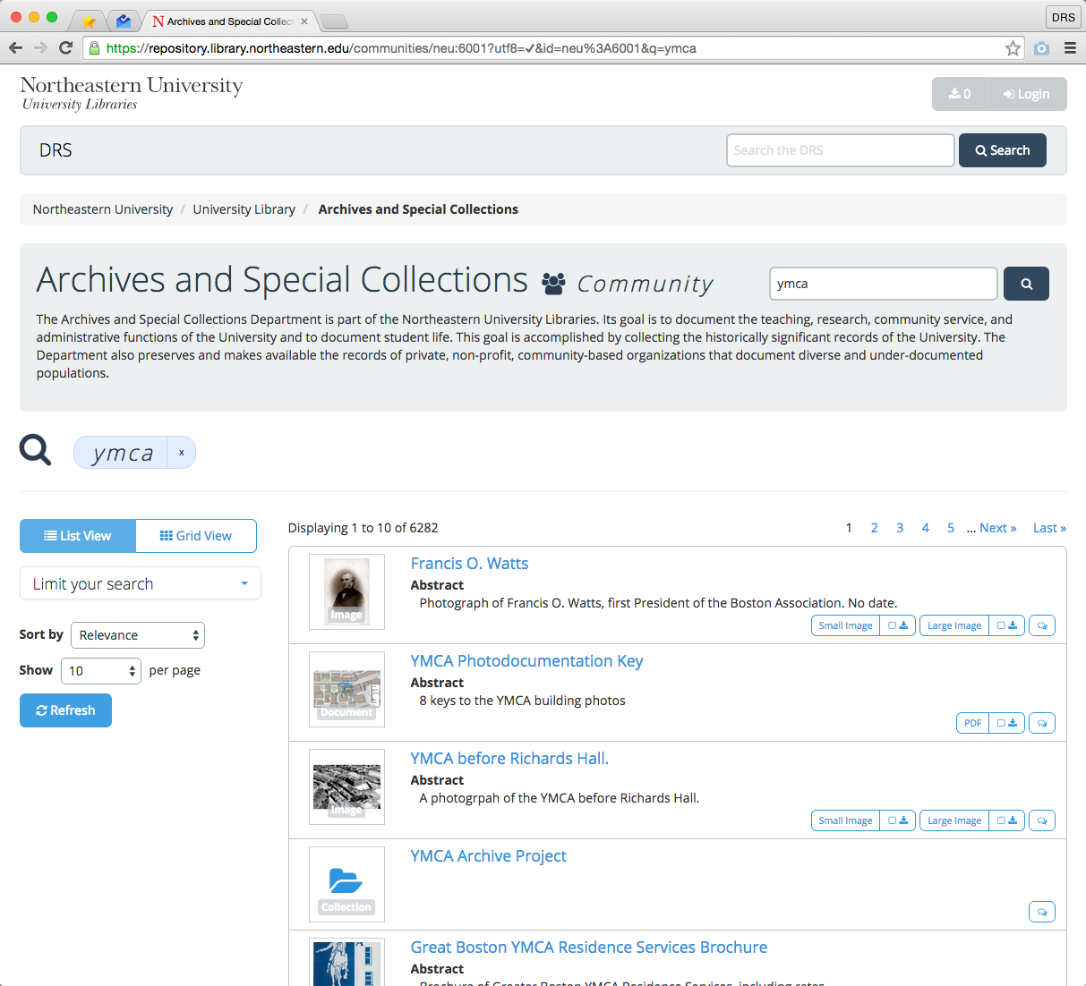
Digital Repository Service: DRS
Why Use the DRS?
To reliably store and preserve work in one secure location.
To easily share valued work with colleagues.
To efficiently discover scholarly content and projects produced at Northeastern.
Who is it for?
Searching and browsing: anyone
Depositing: faculty and some staff

Slide 8
DRS Project Toolkit Pilot Planning
Broad Outline
Refined Elements
Individual objects would be added maintained, and preserved in the DRS
Customizable Wordpress or Omeka site shipped with DRS integration and certain tweaks
Web publishing tool dynamically calls content from the DRS
Search targeted DRS content
Browse targeted DRS content
Facets to refine search and browse results
Download options for DRS content
Support for maps and timelines
Gallery exhibits
Support for non-DRS content

Slide 9
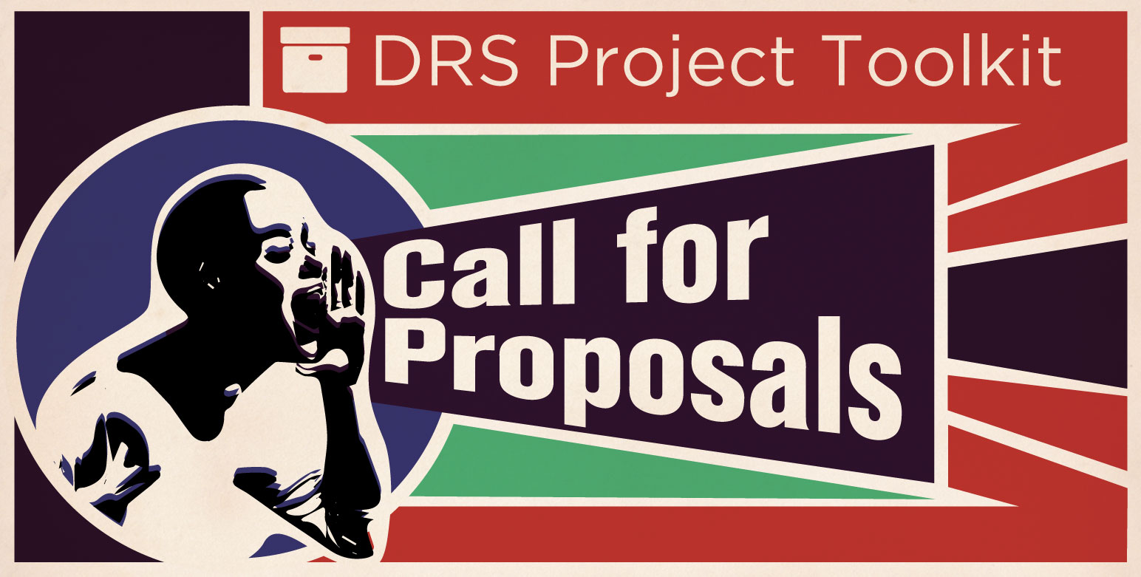
DRS Project Toolkit Call for Proposals
Feasible
Does the project have enough content to display in an WP site?
How much of the content is already digitized?
Suitable
Does the project have the right to distribute the content?
Is the content suitable for ingest into the DRS?
Clone-able/Shareable:
Would the elements of the Toolkit developed for this project be shareable among other Toolkit projects?

Slide 10
The Projects
Student Work Showcase (Digital Media Commons Studios)
Boston Public Schools Desegregation Exhibit (Archives and Special Collections)
Holocaust Awareness Week Programming Exhibit (Holocaust Awareness Committee)
Picturing the World Gallery (University Libraries)
Interviews with Latin American Artists (Stephen Sadow)
Catskills Institute (Phil Brown)

Slide 11
Scalability, Sustainability, and Future Planning
Sustainability and Scalability
Applying updates
Creating new sites
Managed vs. Unmanaged Toolkit sites
Will spin up a full Toolkit Wordpress site, but the project must develop new features on their own with minimal support
Arader vs. NU Press
Future Planning
Out of Pilot
New round of proposals to create new toolkit elements
Future development
Sets integration
Possible integration with other repos
If funded, will implement TEI enabled elements

